Slide 1
STl-FM: STL-Guided Flow Matching
Gawtam Chithra Ramesh
Supervisors : Luzia Knödler, Shaohang Han,
Matthew Lock and Jonathan Styrud

Slide 2
Agenda
Problem definition – What are we trying to solve
Pre-requisites – Common concepts
Background – Overview of literature
Our work – How are we solving it
Results and Analysis – What does it say
Future Work – How this work can be extended

Slide 3
Motivation

Slide 4
Problem Definition
Industrial robot motion is usually programmed once and replayed. Under mass customisation every product variant needs reprogramming by an expert. Learning from demonstration lets a worker on the shop floor teach the task instead
A generative model is used because demonstrations of one task contain several valid motions, and a model that predicts a single motion averages them. [Thesis §1.1]

Slide 6
Overview
Thesis topic : Data driven methods for control under STL specifications
Research Question :
  Can data driven methods leverage formal specifications of STL to generate robust and safe trajectories?
Agenda :
  Background of learning based method for robotic manipulation.
  How can STL be combined with them
  Why combining with STL make them better
  What have I done

Slide 7
Pre-Requisites

Slide 8
Signal Temporal Logic
A formal language
A precise way to say what the robot must do — and when.
01
Vocabulary (Predicates)
NATURAL LANGUAGE
Replacing vague human words with strict physical boundaries.
“Glue the adhesive within 2 seconds
02
Grammar (Logic and Time)
Connecting ideas to form complex, time-bound sequences.
STL
03
Semantics (Robustness)
F[0,2] (glue)
Evaluating not just if a rule is True/False, but how True/False.
Notes:
So, what exactly is Signal Temporal Logic? The easiest way to understand it is to treat it exactly like a spoken language.
[Point to 01 Vocabulary] In any language, you start with basic words or simple facts. In English, you might say, 'I have to reach the office soon.' In STL, our vocabulary words are called predicates. But a robot doesn't understand vague words like 'soon' or 'fast'. Instead, we specify strict boundaries in the physical world that can be turned into math—like 'Time is less than 10 minutes' or 'Speed is under 2 meters per second'.
[Point to 02 Grammar] But individual words aren't enough. Like any other language, you need grammar rules to connect ideas and form complex sequences. We can't just shout the words 'in office' at a machine. We need a grammatical structure to say, 'I need to reach the office within 10 minutes.' STL gives us operators to map out exactly when things need to happen.
[Point to 03 Semantics] Lastly, we have semantics, the meaning of the sentence. Standard logic is Boolean; a sentence is just True or False. Did you reach the office on time, yes or no? But STL is much smarter. It allows us to not only say if something is True or False, but HOW true or HOW false it is. Did you reach the office with 5 minutes to spare, or did you slide in right at the buzzer? We call this continuous margin of safety Robustness, and it is what makes STL so powerful for robotics.

Slide 9
Signal Temporal Logic
Formal Grammar

Slide 10
Signal Temporal Logic
Semantics (Robustness)

Slide 11
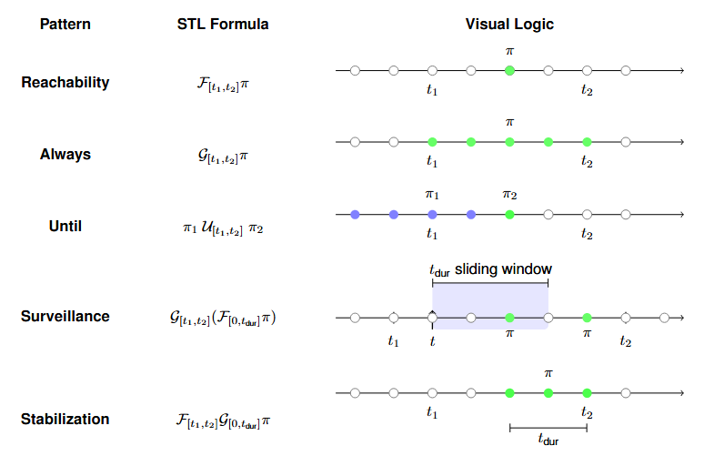
Signal Temporal Logic

Slide 12
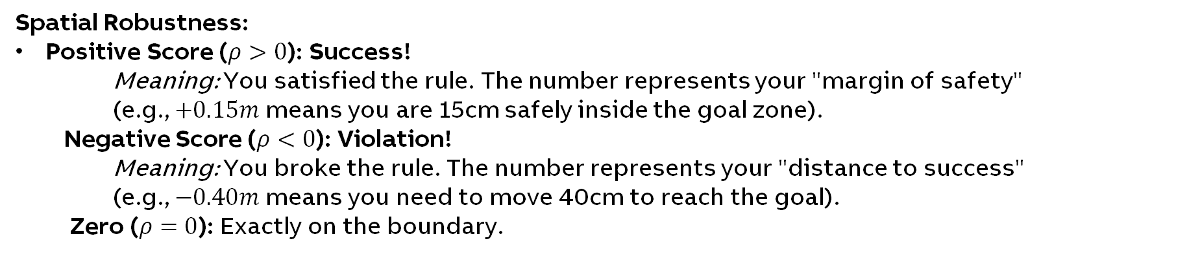
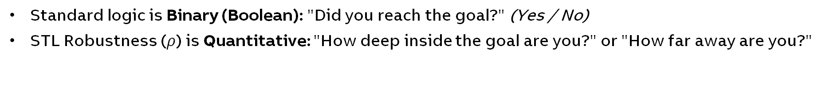
Signal Temporal Logic Evaluation: Robustness
Standard logic is Binary (Boolean): "Did you reach the goal?" (Yes / No)
STL Robustness ($ρ$) is Quantitative: "How deep inside the goal are you?" or "How far away are you?"
Spatial Robustness:
Positive Score ($ρ>0$): Success!
    Meaning: You satisfied the rule. The number represents your "margin of safety" (e.g., $+0.15m$ means you are 15cm safely inside the goal zone).
  Negative Score ($ρ<0$): Violation!
    Meaning: You broke the rule. The number represents your "distance to success" (e.g., $−0.40m$ means you need to move 40cm to reach the goal).
  Zero ($ρ=0$): Exactly on the boundary.

Slide 13
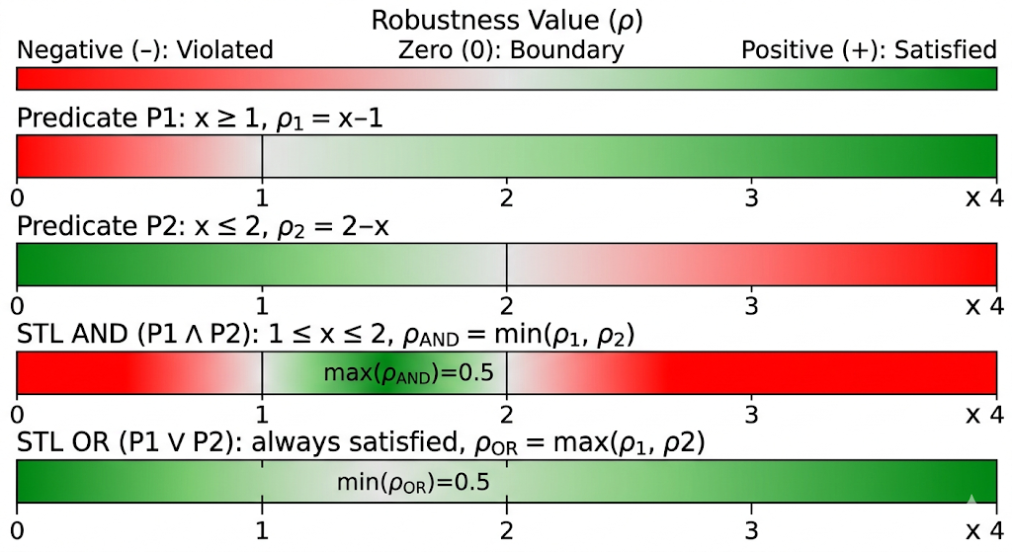
Signal Temporal Logic Evaluation: Robustness
Standard logic is Binary (Boolean): "Did you reach the goal?" (Yes / No)
STL Robustness ($ρ$) is Quantitative: "How deep inside the goal are you?" or "How far away are you?"
Spatial Robustness example :

Slide 14
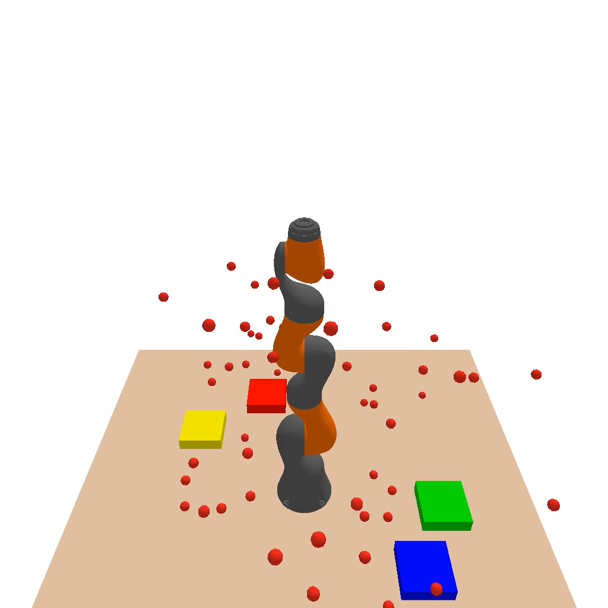
Flow Matching
“Generating” a trajectory
TRAINING
Many robot
Demonstrations
Diffusion
model learns
Motion
prior
"What good robot motion looks like"
INFERENCE
Random
noise
Iterative
refinement
Plausible
trajectory
Denoising steps
[ Diffusion denoising ]
Key insight: Task-agnostic motion prior -- knows how robots move, but not what the task is. Fast, flexible, multi-modal.

Slide 15
Related works

Slide 16
Learning to Manipulate
Generalizability and Safety
1
2
3
Imitation Learning
Reinforcement Learning
Generative Models
Learn from expert
demonstrations. Imitate the closest demonstration.
Learn from trial & error
with a reward signal
Learn trajectory distributions,
generate new ones
Observe picking an object 100 times,
Then mimic my picking
+ve (reward) if you pick,
-ve (penalty) if you collide, …
Understand robot and environment
Generate new scenarios and adapt
Notes:
This is just to give a brief context, there are a lot more methods, each of them can be composed

Slide 17
Learning to Manipulate
Safety??
Generalizability and Safety
Generalizability
1
2
3
Imitation Learning
Reinforcement Learning
Generative Models
Pro : Best, if task is similar to data
(In most cases it is)
Con : You need LOTS of data to generalize
Pro : No need data, agent generates data as it tries
Con : Reward engineering is complex
Pro : Can generalize better
Con : Need data and conditioning
Data (STL-Trajectory pairs)
Data (task agnostic)
Observe picking an object 100 times,
Then mimic my picking
+ve reward if you pick,
-ve if you collide, etc …
Understand robot and environment
Generate new scenarios and adapt
Hypothesis: Can we combine the flexibility of learned models with the formal guarantees of STL?

Slide 18
4 Types of Related works …

Slide 19
Method

Slide 20
Guiding “generation" with STL
Flow matching
Diffusion Model
STL Guidance
Safe Trajectory
Generates candidate
trajectories
(motion prior)
Robustness(ρ) modelled as CBFs steers
denoising toward
task satisfaction
Task-satisfying,
formally verified
robot motion
No retraining
Formal guarantees
Separation of concerns
Swap the STL spec at inference
Applied at generation, not baked in training
(Less hallucination, More explainable)
Motion intelligence + logical reasoning, decoupled
Control Barrier Functions (CBFs) enforce reachability and invariance constraints during the denoising process

Slide 21
Experiments

Slide 22
Results

Slide 23
Discussions

Slide 24
Future Work

